Slide 1
Chapter 10

Slide 2
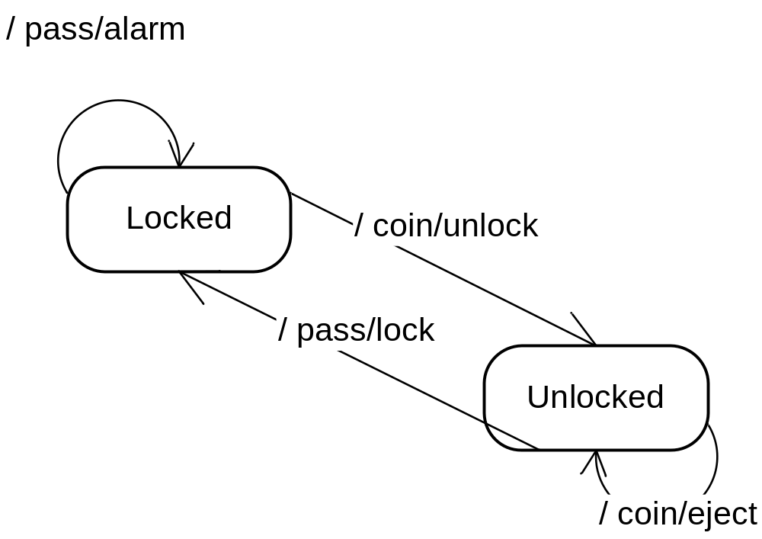
A Pay Turnstile System

Slide 3
State Machines
Very handy for simulating hardware and other stateful systems
A collection of states with transitions
  Transitions determined by input and current state
  Can be accompanied by output

Slide 4
Coding a FSM
Each state must be tracked
  Often use switch/case statements
Input + state = response
See Turnstile.java

Slide 5
Critique of the switch/case Approach
See any design liabilities?
M x N explosion
  Must have a case for every combination of state and event
  Changes will ripple, as usual

Slide 6
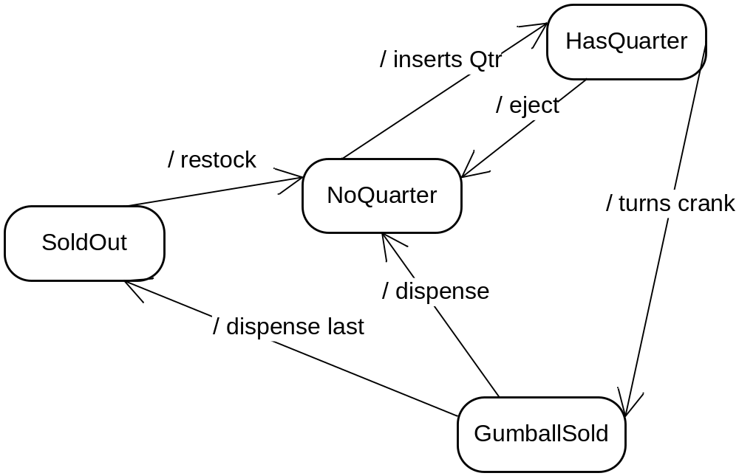
Gumball Machine

Slide 7
Old Gumballs
Before using the state pattern:
(see Old Gumballs folder)
P. 391- 396
(also: Sharpen your pencil)

Slide 8
Another Approach
Transition Tables
  See StateTable.cpp
These are more flexible
  But still are messy, and hard to understand and debug

Slide 9
The State Pattern aka Objects for States
Creates a class hierarchy for the states
  With an interface that models all input stimuli
The host object wraps a state object polymorphically
  When state changes, it points to a different concrete object
You get the flexibility of static transition tables with the efficiency of hard coding
  But you write more code

Slide 10
The State Pattern
Intent:
  Allow an object to alter its behavior when its internal state changes. The object will appear to change its class.
Context:
  An object’s behavior depends on its runtime state. You have a large conditional statement with enumerated constant cases.
Solution:
  Define concrete classes for each state. State classes implement a common interface reflecting possible inputs. State objects can call back to the controlling context if needed, and they can control state transitions as well.

Slide 11
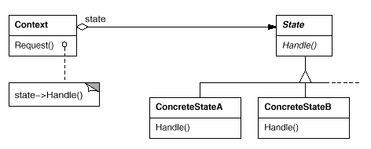
The State Pattern
Class Sketch

Slide 12
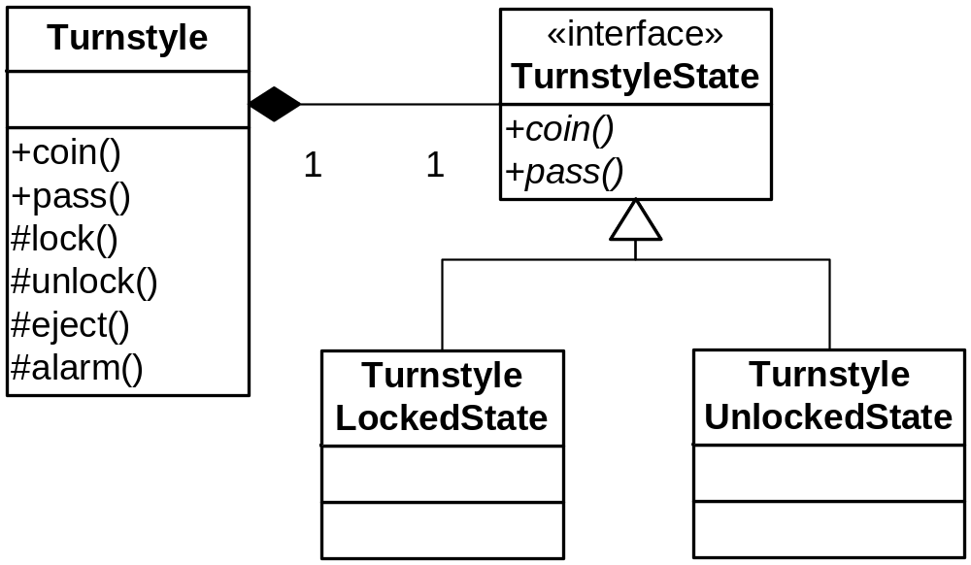
The Turnstile with State
See TurnstileState.java, Turnstile2.java

Slide 13
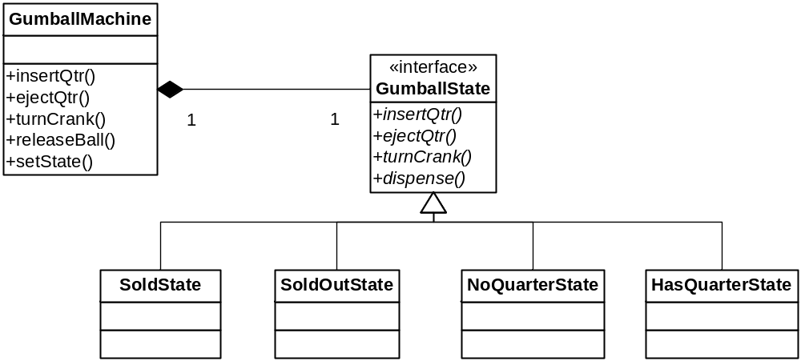
Gumball Machine with State

Slide 14
Sample Files
State.java
NoQuarterState.java
HasQuarterState.java
SoldState.java
SoldOutState.java
GumballMachine.java
GumballMachineTestDrive.java

Slide 15
State vs. Strategy
State classes have a link back to the context
  So they can change the state and call other context methods
  See P. 411

Slide 16
Q&A
Page 412, Questions

Slide 17
Adding a New State
Just add a new concrete class
  And implement the methods, of course
May have to change a transition or two
Example: Winner
  Pp. 413-414

Slide 18
More Q&A
Page 416, Question 1
Page 417, Sanity check questions
Page 422

Slide 19
Duck Hunting
Those pesky ducks just won’t go away!
Let’s check out the state of the flock of ducks…
  Single event method, instead of a separate method for each event:
    Fewer methods
    Easy to add new events (adheres better to OCP)
    But you have if or switches in each State class
    Therefore, best for sparse state handling
  State Objects are Singletons
  Can add a new Event (revive) or State (Hiding)
  Could make the Events their own classes (worth the trouble?)

Slide 20
Remember the Ceiling Fan?
We Used it for Command (See old version)
The Fans have state: High, Medium Low, Off
Let’s add the State pattern!
See Command.java, Sample Command files. (Don’t look at State.java yet.)

Slide 21
Ceiling Fans:
Now that we have states, we can factor much common behavior into the Command base class.
The execute() method can become a Template Method (not shown – how would it look?)

Slide 22
Ceiling Fans: New Command
Cycle through the speeds: High, Medium, Low, Off, High, etc.
With States it is easy!
  (see old version of CycleCommand)
  Create a CycleCommand class
  In all the States, create a nextState method
  That’s pretty much it!

Slide 23
Fireside Chat
Pages 418-419

